Slide 1




Development of NP structures and discourse referencing skill in spoken Cantonese narratives by deaf/hard-of-hearing children in a sign bilingual and co-enrolment setting
Felix Sze, Gladys Tang, Tammy Lau, Emily Lam, Chris Yiu
Centre for Sign Linguistics and Deaf Studies, CUHK

Slide 2

Acknowledgement
This project is one of the research activities of the Jockey Club Sign Bilingualism and Co-enrollment in Deaf Education Programme (2006-2013) supported by the Hong Kong Jockey Club Charities Trust.

Slide 3
Acknowledgement
Deaf/hard of hearing children that participated in the study.
The colleagues and student helpers at the Centre for Sign Linguistics and Deaf Studies who were involved in the data elicitation and transcription process.

Slide 4
Outline of this presentation
Purpose of this study
Literature Review
Research questions specific to language development of deaf/hard-of-hearing children
Methodology
Preliminary Findings
Summary and general discussion

Slide 5
Purpose of this study
In Hong Kong, over 90% of deaf/hard-of-hearing children (hereafter d/hh children) with varying degree of hearing loss study in mainstream schools. Spoken language is the only means of communication for them.
However, very little research has been done on their acquisition of spoken Cantonese.
This project is the first attempt to probe into the development of nominal structures and discourse referencing of these children by looking at their narrative productions.

Slide 6
Literature Review:
Discourse referencing and nominal structures in Cantonese

Slide 7
Literature Review:
What is discourse referencing in narratives?
How different characters are introduced, maintained and reintroduced by nominals in a narrative discourse.
Levelt (1989):
  Adult speakers create and maintain a mental model of a given discourse, and use this model to make decisions about the content and form of utterances.
  Decisions about nominals are based on speaker’s presupposition about the listener’s knowledge of the referent as it is represented in this mental model.
Notes:
Discourse referencing refers to how different characters are introduced, maintained and reintroduced by nominals in a narrative discourse.
When adults select a normal expression, they need to take in account the information status of the referent and the listener’s knowledge of the referent in the ongoing discourse.

Slide 8
Literature Review:
Referencing strategies & (in)definiteness of nominals
Nominals can be specific or non-specific, definite or indefinite, generic or non-generic.
A nominal is said to be specific if the speaker has in mind a particular referent to be referred to.
If the speaker assumes that the referent is identifiable to the addressee
Definite
Specific
If the speaker assumes that the referent is NOT identifiable to the addressee
Indefinite

Slide 9
Literature Review:
(In)definiteness of nominals in Cantonese
In Cantonese, the referential property of a nominal is determined by:
  the internal composition of the nominal
  The syntactic position of the nominal in a sentence

Slide 10
Literature Review:
(In)definiteness of nominals in Cantonese
(Cheng & Sybesma 1999, Matthews & Yip 1994, AuYeung 1997, 2005, among many others)
 | Preverbal position | Postverbal position
Dem + cl + n | Definite (deictic) 呢個男人，把刀 | Definite (deictic) 呢個男人，把刀
num + cl + n | Indefinite 有（一）支筆放係上面 | Indefinite 亞寶要買一把刀
cl + n | Definite 支筆放係上面 | Indefinite or Definite 亞寶要買把刀 Definite 亞寶燙件衫
bare noun | Generic 貓鍾意食魚 | Indefinite 亞寶燙衫 Generic 我唔鍾意貓

Slide 11
Literature Review:
(In)definiteness of nominals in Cantonese
In Cantonese:
  Bare nouns by themselves cannot encode definiteness.
  Classifiers are essential in rendering a definite reading.
  Common nouns can sometimes be used as a proper name (Cheng & Sybesma 1999, AuYeung 2005):
  先生 冇 
  Sin1-saang1 mou6 lei4
  “Teacher didn’t come.” (Cheng & Sybesma 1999)

Slide 12
Literature Review: Acquisition of nominals, (in)definiteness and discourse referencing in Chinese
For Cantonese- and Mandarin-speaking hearing children, nominal structures are acquired much earlier than discourse referencing skills.

Slide 13
Literature Review: Acquisition of NPs in Chinese (Cantonese and Mandarin)
Wong’s (1998) on native Cantonese-speaking children (hearing):
  Bare nouns emerge as early as 1;10
  Children begin to combine elements to form longer noun phrases at around age 2:
    [ det + cl], [num + cl], [noun – noun]
  Pronouns are produced a few months after age 2.
  By 2;10, a wide range of classifiers are used.
  The Cantonese nominals produced by two-year-olds are almost “error-free”.

Slide 14
Literature Review: Acquisition of nominals in Chinese (Cantonese and Mandarin)
Lee’s longitudinal study (2010) on Mandarin-speaking children
  1;05: the first nominals consists of mainly bare nouns, proper names and demonstratives.
  Around age 2: classifier-related structures began to emerge and become productive.
  Full-fledged nominals (dem + num + cl): appear even later and remain scarce before age 2.

Slide 15
Literature Review: Acquisition of (in)definiteness in Chinese
AuYeung (2000):
  by age 3, hearing children have acquired the marking of definiteness in the nominal structure in Cantonese .
  Few errors are produced by kids with regard to the syntactic structures of definite CL-N.
Lee & Szeto’s act-out comprehension task (1996):
  the in/definiteness distinction (i.e. (個婆婆走 ‘The old woman has gone.’ vs有個婆婆走 ‘An old woman has gone.’) was acquired by 5-year-olds.

Slide 16
Literature Review: Acquisition of (in)definiteness in Chinese
Min (1994): longitudinal data from 5 Mandarin-speaking children:
  By three-and-a-half years old, monolingual children of Mandarin demonstrate some knowledge of the distinction between specific and nonspecific referents and can to some extent mark this distinction with appropriate linguistic means.

Slide 17
Literature Review: development of discourse referencing in narratives
Prior developmental studies on hearing children (e.g. Warden1976, Bamberg 1987, Wigglesworth 1990, Wong & Johnston 2004, To 2006, among others)
Younger children (e.g. age 5 or below)
  Tend to use definite nominals, e.g. pronominals, or even null arguments for referent introduction.
  Ambiguous use of pronominals for referents switching.
  Better performance in referent maintenance and reintroduction due to more correct use of definite forms.

Slide 18
Literature Review:
Previous studies on the development of discourse referencing in narratives
Older children (age 6 or above):
  Appropriate use of indefinite nominals for referents introduction begins to emerge at age 6
  Begin to use full-fledged nominals to introduce referents at age 8
  Complete mastery of discourse referencing (i.e. appropriate introduction, reintroduction and maintenance) at age 10 or above.

Slide 19
Literature Review:
Previous studies on the development of discourse referencing in narratives
Wong (2001)
  Comparing typically developing children with children with specific language impairment in the development of discourse referencing in Cantonese.
  Eight 5-year-old SLI children, with language age comparable to 3-year-old normal hearing children.
  The eight SLI children in do not show much difficulty in acquiring discourse referencing
    Able to use existential constructions, determiners, zero forms and pronouns in the story telling task.
    Show similar developmental patterns when compared with normal children of the same language age.

Slide 20
Literature Review:
Previous studies on the development of discourse referencing in narratives
These findings suggest that
  Encoding the information status appropriately in nominals is a late-acquired skill.
  Young children are egocentric and unable to take the perspective of their listeners, resulting in inappropriate coding of information status in nominals in narratives.
  Schaefer and de Villiers (2000): mastery of signaling information status in nominals depends on cognitive developments related to the theory of mind.

Slide 21
Research issues specific to the spoken language development of deaf/hard-of-hearing children (d/hh children)
In general, d/hh children do not have full access to spoken language input, despite the use of assistive hearing devices → language delay is common.
  (e.g. Cole and Paterson 1984, Geers 2006)

Slide 22
Research issues specific to the spoken language development of deaf/hard-of-hearing children (d/hh children)
Delayed language development may also adversely affect d/hh children’s cognitive development.
  Deaf/hard-of-hearing children, particularly those not exposed to sign language input in early childhood, show significant delay in the development of Theory of Mind (i.e. the ability to assess another person’s mental state; see the world through another person’s eyes) (e.g. Schick, De Villers, De Villers & Hoffmeister 2007)
  Delayed development of ToM → delayed acquisition of discourse referencing, which requires assessing the listeners state of knowledge of the discourse referents.

Slide 23
Research issues specific to the spoken language development of deaf/hard-of-hearing children (d/hh children)
Issue specific to the d/hh children acquiring structures of Cantonese in Hong Kong:
  Accessibility to Cantonese varies across d/hh children, depending on the amount of residual hearing.
  In school: exposure to written Chinese which is based on Mandarin, the official language variety in China.
  Significant differences between Cantonese and Mandarin in the nominal structures and the encoding of (in)definiteness.

Slide 24
Major difference in the referential properties of NPs between Mandarin and Cantonese:
(Cheng & Sybesma 1999, Matthews & Yip 1994, AuYeung 1997, 2005, Lee 2010)
 | Cantonese |  | Mandarin
 | Preverbal position | Postverbal position | Preverbal position | Postverbal position
cl + n | Definite 支筆放係上面 | Indefinite or Definite 亞寶要買把刀 Definite 亞寶燙件衫 | *本書 不見了 | Indefinite 我想買本書 (Cheng & Sybesma 1999)
bare noun | Generic 貓鍾意食魚 | Indefinite 亞寶燙衫 Generic 我唔鍾意貓 | Definite 貓要吃餅乾 Generic 貓喜歡吃魚 | Indefinite 老王買筆去了 Definite 老王看完了書 Generic 我不喜歡貓
Notes:
According to Cheng and Sybesma (1999), among others, the major difference in the referential properties of NPs between Mandarin and Cantonese lie in the definite interpretation of bare nouns and [CL + N] phrases. In Mandarin, bare nouns, but not [CL+N], can be definite. In contrast, in Cantonese, [CL+N] can be definite but bare nouns can only be interpreted as indefinite.
What would be the possible predictions?
If d/hh children’s spoken Cantonese development is under the influence of written Mandarin, we would expect that
1. Bare nouns are used to denote definite referents (allowed in mandarin). But we will not see bare nouns introducing referents in preverbal subject position as this iss not permissible in Mandarin (but in fact we see a lot of instances of bare nouns introducing referents in preverabal subject position)
2. Little or no use of CL-N, and if they appear they only are only used in post verbal position for indefinite referents. (12 instances of cl+n denoting definite referents → data like this cannot be acccount for by influence of Mandarin.)
Mandarin influence cannot account for the data distribution → better interpreted the data as a result of language delay.

Slide 25
Given these factors, we expect that acquisition of discourse referencing in Cantonese poses a big challenge to d/hh children in Hong Kong:
  Need to master different types of nominals (demonstratives, classifiers, numerals, bare nouns, etc.) and understand the intriguing relations between different forms and their corresponding referential properties.
  Need to understand that the above two mechanizations are different in Cantonese and written Mandarin.
  Need to constantly assess the listener’s knowledge of referents in the shared discourse in order to encode the information status of the nominals appropriately.

Slide 26
Four major research questions
Overall speaking, what kinds of nominals do the d/hh children in this study use for discourse referencing in Cantonese narratives? Is such pattern comparable to what has been reported for hearing children in the literature? Are there patterns unique to d/hh children?
On the syntactic level, to what extent have the d/hh children in this study acquired the nominal structures in Cantonese as indirectly reflected in the nominals in their narratives?
On the semantic level, to what extent can d/hh children map the different types of nominals with the corresponding semantic properties?
On the pragmatic level, to what extent can d/hh children demonstrate the pragmatic knowledge in choosing the appropriate nominals to facilitate the listener in tracking the referents in a narrative discourse?
Notes:
We will attempt to address the first two questions in this presentation.
Research outline:
Overall speaking, what kinds of referential expressions do d/hh children use for discourse referencing in Cantonese discourse? Are their performance comparable to what has been reported for hearing children in the literature? Do they show any unique patterns?
Give an overall description – Comparing with adult baseline data
Do the referential expressions used by d/hh children show comparable pattern with that of (1) typically-developing hearing children and (2) hearing children with specific language impairment?
Hearing children: initially use definite forms to introduce referents (e.g. zero forms/pronouns); better performance in maintenance and reintroduction due to better use of definite forms.
Hearing children with SLI: a delayed development but performance comparable to their language age as measured by clinical tools.
Findings:
a lot of bare nouns
Patterns not comparable to hearing children
Patterns not comparable to hearing children with specific language impairment.
On the syntactic level, to what extent have d/hh children acquired the nominal structures in Cantonese as indirectly reflected in the referential expressions in the Cantonese narratives?
The results of part 1 suggest that d/hh children are deficient in their knowledge of nominal structure in Cantonese. Is this deficiency a result of delayed development or deviated development?
By ‘delayed development’, we mean that the d/hh children are in the process of acquiring Cantonese nominal structure, albeit with a much slower speed. If this is the case, we would expect the following:
On the semantic level, to what extent can d/hh children map the different NP forms with the corresponding semantic properties appropriately as reflected in their choice of referential expressions for different discourse functions?
On the pragmatic level, to what extent can d/hh children demonstrate the pragmatic knowledge in choosing the appropriate NP forms to facilitate the listener in tracking the referents in a narrative discourse?

Slide 27
Methodology

Slide 28

Methodology – d/hh children
15 d/hh kindergarten and primary school children who are now studying in the sign bilingual co-enrolment programme in a mainstream setting.
Sign bilingual: emphasizes the use of spoken language and natural Hong Kong Sign Language in classes
Co-enrolment: d/hh and hearing children study in the same class (6 d/hh + 15 – 25 hearing classmates)
Jockey Club
Sign Bilingualism and
Co-enrolment in Deaf Education
Programme (2006-2013)

Slide 29
Methodology – d/hh children
Time point: Nov 2008
School grade | Age range | Hearing loss & hearing devices (no. of children) |  | Years of HKSL exposure | Total no. of children
P2 | 7;1-9;11 | Severe-HA | 1 | ~3 | 5
 |  | Severe-CI | 1
 |  | Profound-CI | 3
P1 | 6;3-8;4 | MS-HA | 1 | ~2 | 5
 |  | Severe-HA | 1
 |  | Profound-HA | 2
 |  | Profound-CI | 1
K3 | 5;5-7;1 | Mild-HA | 1 | ~1.5 | 5
 |  | MS-HA | 1
 |  | Severe-HA | 1
 |  | Profound-CI | 2
Notes:
Data collected in Nov 2008
5 children in P2
All have severe or profound hearing loss

Slide 30
Methodology – d/hh children
These 15 d/hh children are grouped into three levels of spoken Cantonese proficiency according to their language age measured by Reynell Developmental Language Scales – Cantonese version

Slide 31
Reynell Developmental Language Scale – Cantonese version
Expressive & Receptive scales
Expressive
  Object naming
  Word definition
  Picture description
Raw score can be converted to language age
Norm up to 7;0

Slide 32
3 levels of spoken Cantonese proficiency
Band | (Expressive) Language age range | No. of d/hh children
A | 2;0 to 3;11 | 2
B | 4;0 to 5;11 | 8
C | 6;0 to ≥ 7;00 | 5

Slide 33
Methodology: narrative elicitation
Adopted from Hickmann (2003)
Story retelling game
  Vocabulary check
  Child is given time to read over the picture sequence
  Child is asked to tell the story to the blind-folded addressee, so that the latter can re-tell the story to the child
B
Child
A

Slide 34
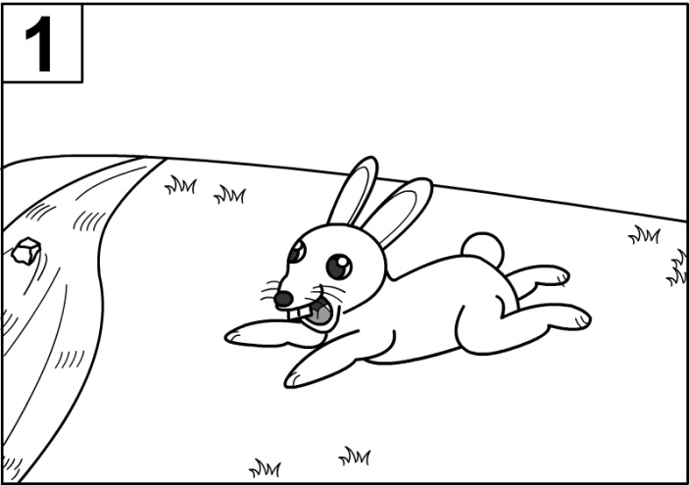
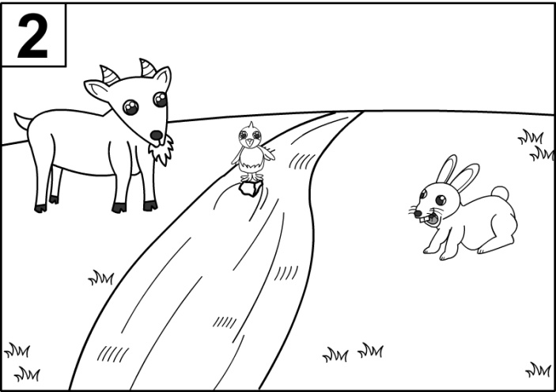
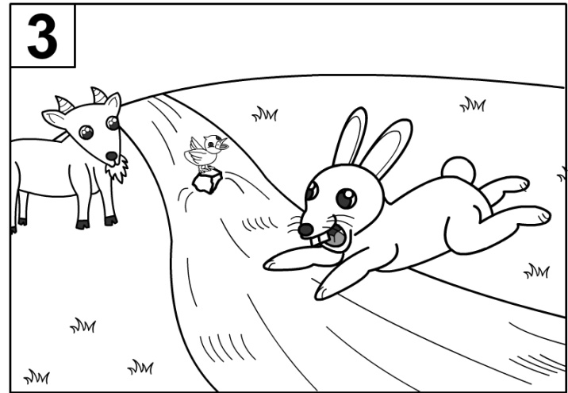
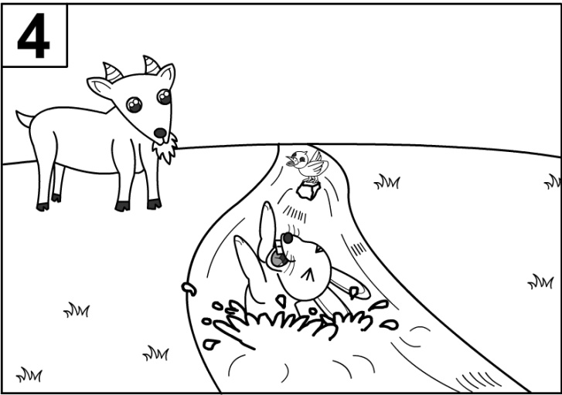
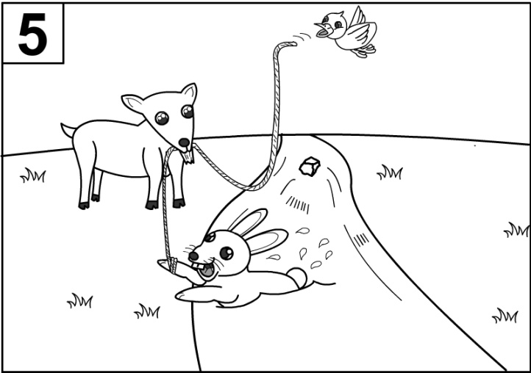
Elicitation materials – Bunny Story
(Modified from Horse story in Hickmann, 2003)
Methodology: narrative elicitation
Notes:
There is a grassland. There is also a river it. A bunny is running across the grassland.
A goat is across the river. A bird is standing on a stone in the river.
The bunny jumps over the river.
Unfortunately, it fell into it.
The bird then flies away to get a rope.
In the end, the goat and the bird rescue the bunny with the rope.

Slide 35
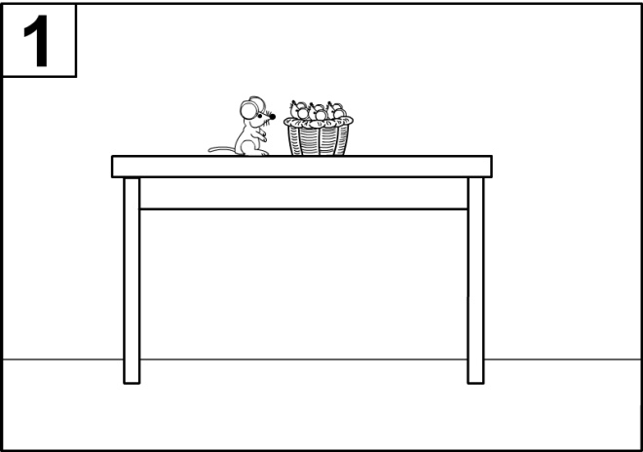
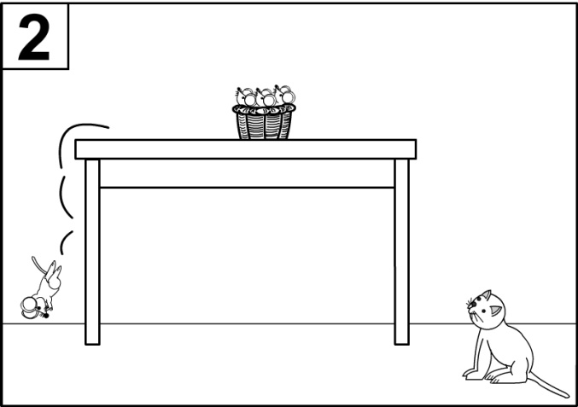
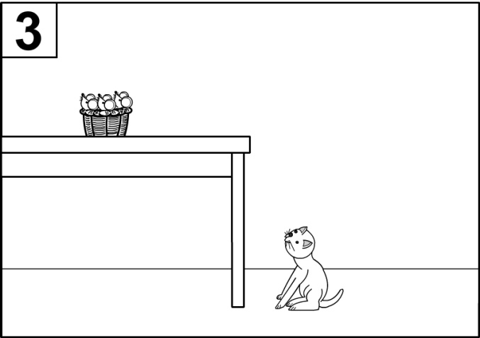
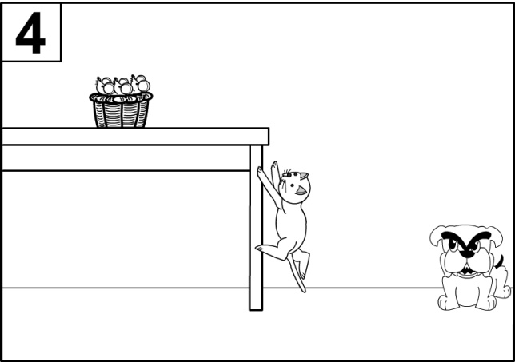
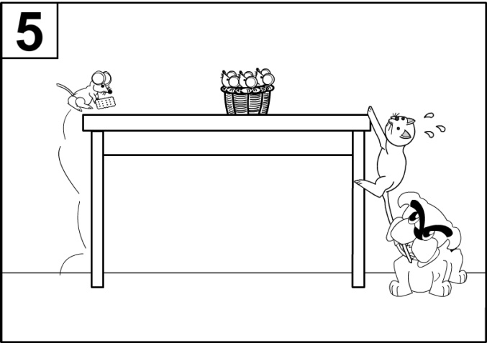
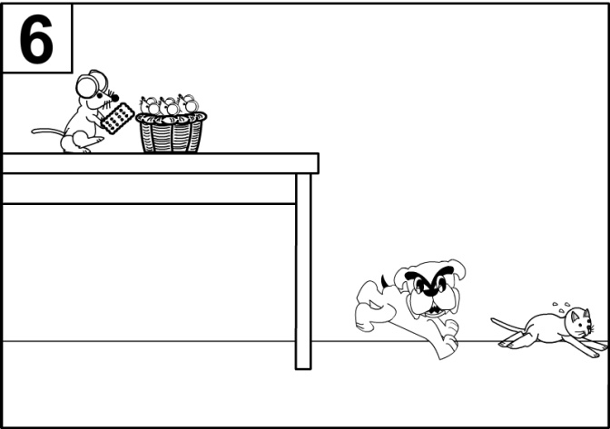
Elicitation materials – Mouse Story
(Modified from Cat story in Hickmann, 2003)
Methodology: narrative elicitation
Notes:
There is mother mouse and some little mice on a table.
The mother mouse goes away to find food. A cat near the table is watching it.
The cat walks more closely to the table.
It plans to climb up the table and catch the little mice.
A dog sees it and bites its tail. At the same time, the mother mouse comes back to the table with a biscuit.
In the end, the cat runs away and the dog chases it. On the table, the mother mouse feeds the little mice with the biscuit.

Slide 36
Methodology: narrative elicitation
The same narratives were elicited from 6 native speakers of Cantonese, 5 females and 1 male, all in their twenties, as baseline data.

Slide 37
Methodology: Data Coding
Data coding:
Referential functions:
  Introduction: a nominal, overt or covert, that is used as the first mention of a character
  Reintroduction: a nominal, overt or covert, is regarded as ‘reintroduction’ if the same character has not been mentioned in the previous utterance.
  Maintenance: a nominal, overt or covert, is regarded as ‘maintenance’ if the same character has been mentioned in the previous utterance.
NP forms
Syntactic position
Other relevant information

Slide 38
Preliminary Findings

Slide 39
Preliminary Findings
Table 1. No. of referential expressions in narratives by adults and d/hh children
Referential functions | Adult hearing speakers n=6 | Deaf and hard of hearing children
 |  | D/hh Total: | Group A (2;0 - 3;11) n=2 | Group B (4;0 - 5;11) n=8 | Group C (6;0 or above) n=5
Introduction | 42 | 85 | 8 | 43 | 34
Maintenance | 103 | 154 | 15 | 93 | 46
Reintroduction | 65 | 120 | 21 | 72 | 27

Slide 40
Referent Introduction: adults
Table 2: Referent introduction in adult narratives
 | No. of tokens | % | Examples:
Existential | 31 | 74% | 咁呢就有一隻兔仔啦
Cl + N (subj/topic) | 3 | 7% | …咁隻貓呢就見到…
Cl + N (postverbal) | 2 | 5% | …咁呢就嚟咗隻貓喎.
num + Cl + N (obj) | 2 | 5% | …個主人呢其實就養咗一隻貓架喎…
num + Cl + N (nominal predicate) | 2 | 5% | …咁喺張檯上面呢就有個籃喎. 原來呢,係一dau5老鼠bi4bi1啦…
num + Cl + N (postverbal) | 1 | 2% | 石仔上面企咗一隻雀仔…
bare NP (subj) (any NPs without demonstrative /classifier /numeral) | 1 | 2% | …咁呢老鼠媽媽呢就喺出面…
Notes:
For adult Cantonese native speakers, existential constructions is the most common way to introduce a referent (74%). There are also other means to introduce a referent, such as [classifier – noun] in the postverbal position, but they are far fewer in numbers.

Slide 41
Referent Introduction:
Hearing adults vs d/hhchildren:
Table 3: Referent Introduction | Hearing Adult |  | D/hh children (total) |  | Group A (2;0 - 3;11) 2 d/hh children |  | Group B (4;0 - 5;11) 8 d/hh children |  | Group C (6;0 or above) 5 d/hh children
 | Tokens | % | Tokens | % | Tokens | % | Tokens | % | Tokens | %
Existential | 31 | 74% | 24 | 28% | 2 | 25% | 12 | 28% | 10 | 29%
Cl + N (subj) | 3 | 7% | 5 | 6% |  |  |  |  | 5 | 15%
Cl + N (postverbal) | 2 | 5%
num + cl + n (obj) | 2 | 5% | 1 | 1% |  |  | 1 | 2%
num + Cl + N (nominal predicate) | 2 | 5%
num + Cl + N (postverbal) | 1 | 2%
bare NP (subj) | 1 | 2% | 39 | 46% | 6 | 75% | 23 | 53% | 10 | 29%
bare NP (obj) |  |  | 12 | 14% |  |  | 4 | 9% | 8 | 24%
cl + n (obj) |  |  | 1 | 1% |  |  |  |  | 1 | 3%
dem + Cl + N (subj) |  |  | 1 | 1% |  |  | 1 | 2%
num + Cl + N (subj) |  |  | 1 | 1% |  |  | 1 | 2%
other |  |  | 1 | 1% |  |  | 1 | 2%
Notes:
When we look at the referent introduction by d/hh children, a very different picture emerges.
An extremely high % of bare nouns (in both subj and obj position) are used by these children, and the percentage slightly decreases as the language age increases.
Another major difference is that d/hh children use far few existential constructions when compared to adults.
Need to highlight that the task does not include a lot of num + cl + n

Slide 42
Deaf/hard of hearing children: Referent Introduction
In general, d/hh children overuse bare nouns for referent introduction.
Examples:
*CHI: 兔仔 跑步 .
(Group A, language age 2;0 – 3;11 , first line in the story)
*CHI: 跟住 , 貓 想 食 老鼠 .
(Group B, language age 4:0 – 5:11, 1st mention of ‘cat’.)
*CHI: 跟住 兔仔 又 見 到 <馬 # 唔係> [///] 羊 .
(Group C, language age =/> 6;0, 1st mention of ‘goat’)

Slide 43
Deaf/hard of hearing children: Referent Introduction
Use of existential constructions is limited, initially associated with errors such as missing or inappropriate classifiers.
missing classifiers
  *CHI: 有 貓 . (Group A, language age 2;0 – 3;11)
  *CHI: 跟住 # 有 雀仔 # 石頭 # 企 # 有 羊 .
  (Group B, language age 4;0 – 5;11)
Inappropriate classifiers
  *CHI: 跟住 呢 # 有 個 # 小鳥 # 行 [///] # 飛 過 隻 頭 嘅上面 .
  (Group C, language age 6 or above)

Slide 44
Deaf/hard of hearing children: Referent Introduction
Very few tokens of misusing definite nominals to introduce a new referent
  *CHI: 個兔仔 ## 要行過去
  (Group C, language age 6 or above, first line in the narrative)
  Note that previous studies report that hearing children below age 6/7 tend to use pronouns, null arguments and definite nominals to introduce referents → this pattern is not prominent in the narratives by d/hh children of comparable language age.

Slide 45
Referent maintenance: hearing adults
Table 4: Referent maintenance in adult narratives
 | Tokens | % | Examples
Bare NPs | 11 | 11% | 有一堆老鼠仔喺檯上面. 咁有老鼠媽媽, 跟住老鼠媽媽要出去搵嘢食嘞.
Cl + N | 23 | 22% | 隻貓呢又想食咗啲老鼠仔, 好嘞, 咁當隻貓擒上去張檯嘅時候呢,
Null arguments | 39 | 38% | 咁隻兔仔呢就想跨過條河, null就想跳過去. 咁但係呢null就唔小心就跌咗入條河入面喎
pronouns | 30 | 29% | 有隻兔仔呢, 佢就跑緊啦.
Notes:
For adults:
Null arguments the most frequently used option for reference maintenance (38%), followed pronouns (29%) and definite NPs consisting of a classifier-noun combination.

Slide 46
Referent maintenance: hearing adults vs d/hh children
Table 5: Reference Maintenance in adults & d/hh children | Hearing Adults n=6 |  | D/hh children (total) |  | D/hh children divided into different language age groups
 |  |  |  |  | Group A (2;0 - 3;11) n=2 |  | Group B (4;0 - 5;11) n=8 |  | Group C (6;0 or above) n=5
 | Tokens | % | Tokens | % | Tokens | % | Tokens | % | Tokens | %
Bare NPs | 11 | 11% | 69 | 45% | 9 | 60% | 37 | 40% | 23 | 50%
Cl + N | 23 | 22% | 4 | 3% |  |  | 1 | 1% | 3 | 7%
null arguments | 39 | 38% | 65 | 42% | 6 | 40% | 48 | 52% | 11 | 24%
pronnouns | 30 | 29% | 14 | 9% |  |  | 7 | 8% | 7 | 15%
Num + cl + n |  |  | 1 | 1% |  |  |  |  | 1 | 2%
existential |  |  | 1 | 1% |  |  |  |  | 1 | 2%
Total: | 103 |  | 154 |  | 15 |  | 93 |  | 46
Notes:
General observations:
D/hh children, in contrast:
Bare NPs remains to be prominent across all three language age groups.
While null arguments are also frequently used, pronouns and classifier-noun sequences are surprising low.

Slide 47
Referent maintenance: d/hh children
For d/hh children
Bare NPs remains to be prominent across all three language age groups for referent maintenance.
  *CHI: 兔仔 喺 度 跳 河 .
  *CHI: 但係 # 兔仔 跌 咗 河 度 .
(Group B, language age 4;0 – 5;11)
While null arguments are also frequently used, pronouns and [Cl + N] structures are surprising low.

Slide 48
Referent reintroduction: hearing adults vs d/hh children
Referent reintroduction | Adults n=6 |  | D/hh Children (total) n=15 |  | D/hh children divided into different language age groups
 |  |  |  |  | Group A (2;0 - 3;11) n=2 |  | Group B (4;0 - 5;11) n=8 |  | Group C (6;0 or above) n=5
 | Tokens | % | Tokens | % | Tokens | % | Tokens | % | Tokens | %
Ah + N | 2 | 3%
Bare NPs | 15 | 23% | 93 | 78% | 18 | 86% | 58 | 81% | 17 | 63%
Cl + N | 39 | 60% | 8 | 7% |  |  | 2 | 3% | 6 | 22%
dem + Cl + N | 4 | 6% | 1 | 1% |  |  | 1 | 1%
pronouns | 5 | 8% | 3 | 3% |  |  |  |  | 3 | 11%
existential constructions |  |  | 2 | 2% |  |  | 1 | 1% | 1 | 4%
Null arguments |  |  | 13 | 11% | 3 | 14% | 10 | 14%
Total: | 65 |  | 120 |  | 21 |  | 72 |  | 27
Notes:
Referent reintroduction:
For adults, an NP consisting of a classifier and a noun most frequently used option for reintroducing a character (over 60%). Bare NPs are sometimes used as if they are proper names. Pronouns are not preferred, probably due to the need to avoid ambiguity in interpretation.
For d/hh children, however, bare NPs are predominant in the re-introduction of characters. [Classifier + noun] begins to increase as language proficiency improves, but it remains to be scarce when compared to bare NPs. There are even a few instances of indefinite existential constructions and null arguments which necessarily render switching of referents unclear to the address.

Slide 49
Referent reintroduction: adults vs d/hh children
For hearing adults:
  [Cl + N] is most frequently used option for reintroducing a character (over 60%).
  Bare NPs are sometimes used as if they are proper names.
  Pronouns are not preferred, probably due to the need to avoid ambiguity in interpretation.

Slide 50
Referent reintroduction: adults vs d/hh children
For d/hh children, however:
  bare NPs are predominant in the reintroduction of characters.
  [Cl +N] begins to increase as language proficiency improves, but it remains to be scarce when compared to bare NPs.
  There are a few instances of inappropriate use of indefinite existential constructions and null arguments.

Slide 51
Summary and General discussion
Predominance of bare NPs as the referential expressions by d/hh children in this study across different language age groups. (Unlike what has been reported on the discourse referencing development of hearing children).
While nominal structures are acquired early by hearing children, not all of the d/hh children in this study can produce the full range of nominal forms in their narratives, despite a progress in the general language proficiency (as measured by clinical tool such as Reynell Developmental Language Scale).

Slide 52
What underlies the predominance of bare NPs: influence from written Mandarin?
What underlies the predominance of bare nouns in d/hh children’s Cantonese narratives?
The first possible explanation is d/hh children’s exposure to written Chinese (based on Mandarin) which is more accessible to them than spoken Cantonese.

Slide 53
What underlies the predominance of bare NPs: influence from written Mandarin?
Influence of written Mandarin may explain the use of bare NPs for definite referents in preverbal and postverbal position, and indefinite referents in postverbal position. However, it fails to explain satisfactorily the prevalence of bare NPs for indefinite referents (46%) in the data, which is not a grammatical option in Mandarin.
Use of bare nouns by d/hh children
Referential status | Discourse functions | Preverbal position | Postverbal position | Total no. of nominals
Indefinite | introduction | 39 (46%) | 12 (14%) | 85
Definite | maintenance | 51 (33%) | 17 (11%) | 154
 | reintroduction | 59 (49%) | 32 (27%) | 120

Slide 54
What underlies the predominance of bare NPs: influence from written Mandarin?
Neither can influence of Mandarin explain the gradual increase of [Cl + N] for definite referents in the preverbal (8 tokens) and postverbal positions (4 tokens) (grammatical in Cantonese) produced by d/hh children of a relatively more advanced language age.

Slide 55
What underlies the predominance of bare NPs: influence from Hong Kong Sign Language?
  The d/hh children in this study are studying in a sign bilingual co-enrolment program in which HKSL is used alongside with spoken languages in the classroom.
  Bare nouns can be either definite or indefinite in HKSL (Sze 2000, Tang & Sze 2002) → language transfer?? particularly for d/hh children whose dominant language is HKSL??

Slide 56
What underlies the predominance of bare NPs: influence from Hong Kong Sign Language?
Yet, preliminary observation of the acquisition of 將-construction by mainstreamed deaf students who don’t know sign language also show the predominance of bare NPs.
This suggests that the predominance of bare NPs and delayed acquisition of classifiers in the current data is probably a general phenomenon among d/hh children and may not be attributable to language transfer from sign language.

Slide 57
What underlies the predominance of bare NPs: delayed development of nominal structures?
  The third possible explanation is that the predominance of bare NPs in the data simply reflects a delayed development of nominal structure by d/hh children due to their limited access to spoken Cantonese.
  Recall that in acquisition of NPs in both Cantonese and Mandarin, bare nouns appear very early on and classifier appear at a later stage. (i.e. functional categories are acquired late when compared to lexical categories)

Slide 58
What underlies the predominance of bare NPs: delayed development of nominal structures?
  If the development of nominal structures of d/hh children is simply delayed rather than deviated, we would expect to see:
    Evidence that the developmental sequence of different NPs types of d/hh children parallels that of hearing children.
    Evidence that d/hh children show some sensitivity to the mapping between nominals and referential status, just like what hearing children have demonstrated in other studies (e.g. Min 1994)
    Evidence that d/hh children are sensitive to the syntactic structure of nominals in Cantonese.

Slide 59
What underlies the predominance of bare NPs: delayed development of nominal structures?
  Preliminary observations of some of the d/hh children’s developmental data over time do suggest that this is the case:
  Developmental sequence:
    Bare NPs, zero forms > pronouns > Cl + N > full-fledged NPs
  Sensitivity towards the relationship between nominals and referential/discourse functions:
    Null arguments and pronouns are used mainly for referent maintenance.
    Lexical NPs (e.g. bare NPs, Cl + N, det + num + Cl + N) are preferred over null arguments and pronouns for referent reintroduction.
Notes:
)(early production of pronouns indicate existence of full structure so delayed development is simply underspecification)

Slide 60
What underlies the predominance of bare NPs: delayed development of nominal structures?
Sensitivity towards the syntactic structure of Cantonese nominals:
  Dem + num + cl + adj + n
  Out of 281 overt nominals in the data, we found no instance of violation of the syntactic structures of nominals in Cantonese.
  The above observations are preliminary. Further research is warranted.

Slide 61
References:
Au-Yeung, Ben Wai-Hoo. 1997. The Lexical Classifier Parameter and The L2 Acquisition of Cantonese Nominals. Unpublished M. Phil. Thesis. CUHK.
Au Yeung, Ben. 2000. Setting the Lexical Classifier Parameter in Child Cantonese. Paper presented in Annual Research Forum, Linguistic Society of Hong Kong Dec 9-10, City U of HK.
Au Yueng Ben, 2005. An interface program for parameterization of classifiers in Chinese. Ph.D dissertation. The Hong Kong University of Science and Technology.
Bamburg, M. 1987. The acquisition of narratives. Berlin: Walter de Gruyter.
Cheng, Lisa & Rint Sybesma. 1999. Bare and not-so-bare nouns and the structure of NP. Linguistic Inquiry, 30(4), 509-542.
Cole, E., & M. Paterson. 1984. Assessment and treatment of phonological disorders in the hearing-impaired. In J. Castello (ed.) Speech disorders in children, p.93-127, San Diego: College-Hill Press.

Slide 62
Geers, Ann. 2006. Spoken Language in Children with Cochlear Implants. In Patricia Spencer & Marc Marschark (eds.) Advances in the Spoken Language Development of Deaf and Hard-of-Hearing Children, p.244-270. NewYork: Oxford University Press.
Hickmann, Maya (2003) Children’s Discourse: Person, Space and Time Across Languages. Cambridge: Cambridge University Press.
Lee, Thomas. 2010. Nominal Structure in Early Child Mandarin. In Chris Wilder and Tor A. Afarli (eds.) Chinese Matters: From Grammar to First and Second language Acquisition. Trondheim, Norway: Tapir Academic Press. Pp.75-109.
Levelt, W.J.M. 1989. Speaking-from intention to articulation. Cambridge, MA:MIT
Matthews, Stephen, and Virginia Yip. 1994. Cantonese: A comprehensive grammar. London: Routledge.
Schafer, R. & J. de Villiers. 2000. What a and the can tell us about the emergence of DP. In BUCLD 24 Proceedings , ed. S. Catherine Howell et al, 609-620. Somerville, MA: Cascadilla Press.
Schick, Brenda, Peter De Villers, Jill De Villers and Robert Hoffmeister. 2007. Language and Theory of Mind: A study of deaf children. Child Development, 78(2), 376-396.

Slide 63
Sze, Felix. 2000. Space and Nominals in Hong Kong Sign Language. Unpublished M.Phil thesis. The Chinese University of Hong Kong.
To, Carol K.S. 2006. Use of Reference in Cantonese Narratives: A Developmental Study. Ph.D dissertation, The University of Hong Kong
Tang, Gladys & Felix Sze. 2002. Nominal expressions in Hong Kong Sign Language: does modality make a difference? In Meier, Richard P. / Cormier, Kearsy / Quinto-Pozos, David (eds) Modality and structure in signed and spoken language. Cambridge: Cambridge University Press. pp. 296-319
Warden, D. A. 1976. The influence of context on children‘s use of identifying expressions and reference. British Journal of Psychology, 67, 101–112.
Wigglesworth, G. 1990. Children''s narrative acquisition: A study of some aspects of reference and anaphora. First Language, 10(29), 105-125.
Wong, Anita Mei Yin. 2001. Who are you talking about? The development of reference in Cantonese-speaking children with and without specific language impairment. Ph.D dissertation. The University of British Columbia. .
Wong, Anita M.Y. & Judith Johnston. 2004. The development of discourse referencing in Cantonese-speaking children. Journal of Child Language, 31, p.633-660.
Wong, Sin-Ping Cathy. 1998. The Acquisition of Cantonese Noun Phrases. UMI Ph.D dissertation, University of Hawaii.

